Slide 1


CLAREMONT PRIMARY SCHOOL NEWSLETTER
FRIDAY 26TH SEPTEMBER 2025
Dear Parents and Carers, It has been a whirlwind start to the year and the classes are all no well into their curriculum learning. School is looking and feeling smart with the children resplendent in their school uniforms. Thank you for your support with this. It has been great to see so many of our families come into school for our parent meetings. I hope that you have found them useful – I have received a lot of positive feedback but if there is anything that we could do to improve them for you, please let us know. Attendance is improving after a bit of a slow start. Please remember how important it is for your child to attend school every day that they can – our learning builds over time and non-attendance or persistent lateness can have a significant impact on their learning. Please ensure that your child reads daily and that you sign their reading diary and also that they practise their number skills through Numbots or TTRockstars. It is starting to get colder, so please make sure that your child brings and wears their coat (with their name written in it) every day. Have a great weekend Best wishes, Rob Campbell Headteacher
Dates for your diary: 6th – 9th October – Book Fair 8th October - Reception Stay and Play classes 15th and 16th October – PTFA Discos 17th October – Show Racism the Red Card Day 20th October – First day of ½ term holidays 18th November – Yr 6 trip to Beaumanor Hall 27th November – Individual Photographs
Show Racism the Red Card
On 17th October Claremont will be showing racism the red card. This is the first of our charity days this year where we will be raising awareness and funds for the Show Racism the Red Card project.
In a world where differences are perceived to be widen communities, I want to bring our community together and stand firm against racism. Racism is never OK and it is one of the biggest threats to peace in our world today. It has no place at Claremont where all are welcome and all are treated with equity and equality. More details will follow about the specifics of the day and I know that we all wear red already, but we cannot let this important opportunity pass us by. I hope that you will all join me in Showing Racism the Red Card.
Uniform
I am really pleased with the uptake of school uniform – it is expected that the children come school in uniform and the vast majority are. There seems to be some confusion about PE kit though. To confirm – PE kit is black shorts/leggings/joggers, a white or red T-shirt and trainers (preferably black). The children should wear their red sweatshirts to keep warm during the day.
Attendance: Our attendance target is 96% Last week’s attendance was 93.4%
Safeguarding children is everyone’s responsibility. At Claremont, we are committed to keeping our children safe from harm. Mr Campbell, Miss Davis , Mrs Cundy, Mrs Khan, Mr Greaves & Mrs Eager have responsibility for safeguarding and child protection. If we have any concerns reported to us, we will always take action to protect a child and inform the relevant agencies where necessary..

Slide 2
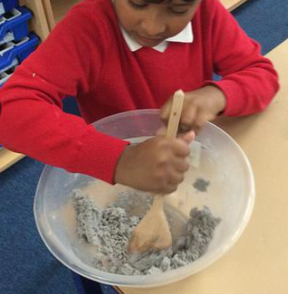

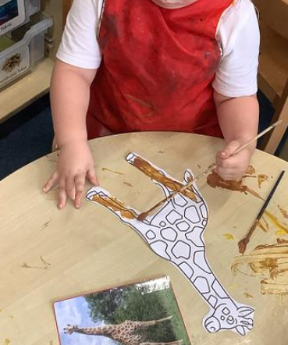


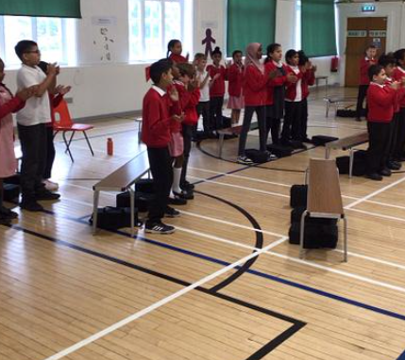
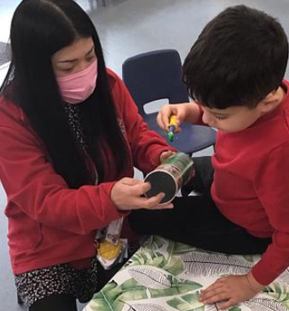
What have we been learning this week? Nursery have been reading Dear Zoo and painting the animals from the story. Reception have been continuing their letters and sounds work – please keep an eye out for the sound of the day! Year 1 have been getting ready for their trip to the Goose Fair – a classic Nottingham tradition. Year 2 have been making moon rocks as part of their History learning. Year 3 had an exciting adventure when their swimming bus broke down but they still managed to have an excellent swimming lesson!. Year 4 have started their clarinet lessons in music – it was amazing! Year 5 have been preparing for their Black History Month assembly next week, learning songs and hearing about the positive impact of migration to Nottingham. Year 6 have been taking part in a baseline assessment, ready for their SATs this year. It was hard work but will point the way to go to improve. Acorns have been practising their painting skills and learning their letters and sounds..
Recommended Reads
Dear Zoo by Rod Campbell – Everybody enjoys lifting the flaps to discover which animals the zoo has sent..
Ruby’s Worry by Tom Percival. Ruby loves being Ruby until she discovers a small worry, that gets bigger and bigger….
Crater Lake by Jennifer Killick – Who is the mysterious man who stops the coach on the way to Crater Lake?
Behaviour and Relationships Relationships and behaviour are key elements to children’s development. At Claremont, we have the highest expectations for our pupils to learn how to treat each other with respect, care and consideration. Through our curricular and pastoral work, we reinforce these expectations and help children to understand why they are so important. We celebrate these weekly at our Friday assemblies. Please support our work in this area and talk to your child about how their day was, how they interacted with others and how they coped when things didn’t go their way. Together we can help our children to become ready for the next stage of their learning journey.,
Safeguarding children is everyone’s responsibility. At Claremont, we are committed to keeping our children safe from harm. Mr Campbell, Miss Davis , Mrs Cundy, Mrs Khan, Mr Greaves & Mrs Eager have responsibility for safeguarding and child protection. If we have any concerns reported to us, we will always take action to protect a child and inform the relevant agencies where necessary.

Slide 3


