Slide 1


CLAREMONT PRIMARY SCHOOL NEWSLETTER
FRIDAY 12TH SEPTEMBER 2025
Dear Parents and Carers, Welcome to the first Newsletter of the new academic year. We are 8 days in now and we have made a fabulous start to the year. I am so delighted to see all of our pupils in uniform (more about that later), settling in with their new teachers and cracking on with the hard work. We have a number of things that we will be working on this year: As always attendance is high on our list of priorities – if the children are not in school, on time, then they will fall behind their peers. Reading is the key to success and unlocks so many doors to the future. Times tables are the key to unpicking multiplication, division and fractions (a big focus for Year 4 this year!) Most importantly learning how to get on with each other and how to behave appropriately in class and across the school is going to help to drive us forwards. I am really looking forward to meeting you all again and engaging with you as we go through the year. Finally, keeping us all safe is the highest priority and we are 100% committed to ensuring that all of our children are free from harm and the fear of harm Best wishes, Rob Campbell Headteacher
Dates for your diary: 16th September – Parent meetings start 19th September – Pupil elections take place 24th September – McMillan Coffee Morning 8th October – Reception Stay and Play classes 20th October – First day of ½ term holidays
PTFA
Claremont are proud for the second year running to have a PTFA run by staff and parents.
What is a PTFA
A PTFA (Parents, Teachers & Friends Association) does:
The PTFA is a group of parents, carers, staff and friends of the school who work together to support our children’s learning and school life. We help to:
* Organise fun events and activities for pupils and families.
* Fundraise for extra resources and experiences that benefit all children.
* Strengthen the school community by bringing people together.
Whether you’d like to get involved, share ideas, or simply enjoy a cup of coffee, the Wednesday morning meet-up is a great place to start. Everyone is welcome – we’d love to see you there!
Uniform School uniform is really important as it gives our children a sense of collective pride, identity and community. Please ensure that your child attends wearing the correct uniform. Please do not send them into school wearing jewellery as this can often get lost or damaged. Please also ensure that every item of uniform is clearly marked with your child’s name and class.
Attendance: Our attendance target is 96% Last year’s attendance was 93.4%
Safeguarding children is everyone’s responsibility. At Claremont, we are committed to keeping our children safe from harm. Mr Campbell, Miss Davis , Mrs Cundy, Mrs Khan, Mr Greaves & Mrs Eager have responsibility for safeguarding and child protection. If we have any concerns reported to us, we will always take action to protect a child and inform the relevant agencies where necessary..

Slide 2

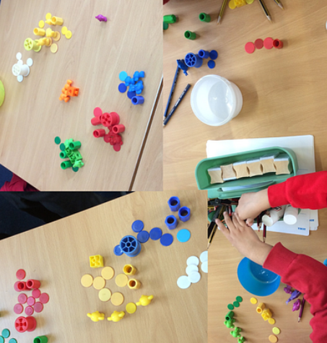
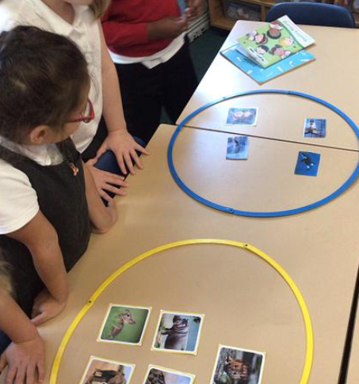

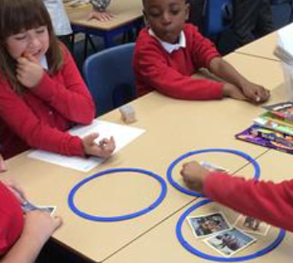
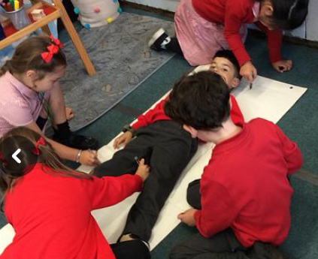
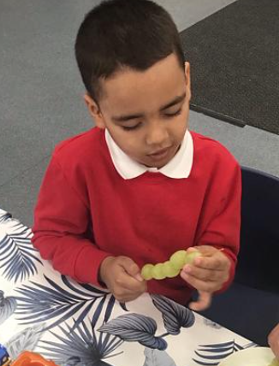
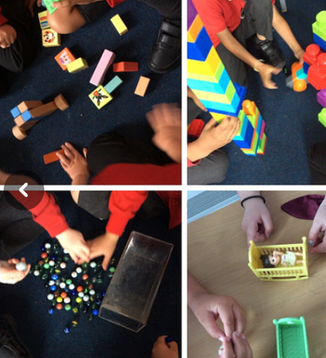
What have we been learning this week? Nursery have enjoyed settling in, making new friends and getting to know their new classroom area. Reception have been learning all about the Colour Monster and how it can help us understand how we feel. Year 1 have been sorting items into different groups in Maths Year 2 were classifying mammals in science, learning all about what they eat. Year 3 had a spectacular start to their Stone Age topic and went for their first swimming lesson.. Year 4 have been setting up their TTRockstars accounts and getting ready to smash their times tables!! Year 5 have been learning about Chinese Dynasties and working together to build towers. Year 6 have hit the ground running, learning all about the expectations for their final year at Claremont! Acorns have been exploring their new environment, mak9ing new friends and taking turns singing and learning lots of new songs.
Recommended Reads
The Gruffalo by Julia Donaldson and Axel Scheffler – A tale of a mouse’s adventure in the deep , dark wood.
The Very Hungry Caterpillar by Eric Carle is a story about a caterpillar’s search for food and his journey to become a butterfly!
Parent Meetings This year we are inviting you into school to visit with your child’s new class teachers. Each Year Group will open their doors after school so that you can come in, meet the team and find out about the learning, timetables and expectations. These will take place after school in the classrooms from 3.45 – 4.15pm and the timetable is as follows: Year 1 – Tuesday 16th September Year 2 – Wednesday 17th September Year 3 – Tuesday 23rd September Year 4 – Wednesday 24th September Year 5 – Wednesday 1st October Year 6 – Thursday 18th September Early Years (Reception and Nursery) have already planned and communicated their parental meetings. It is really important to me this year that we communicate with each other even more effectively than we have. Please make use of ClassDojo to stay in touch and up to date with what is going in your child’s class and the school.
Safeguarding children is everyone’s responsibility. At Claremont, we are committed to keeping our children safe from harm. Mr Campbell, Miss Davis , Mrs Cundy, Mrs Khan, Mr Greaves & Mrs Eager have responsibility for safeguarding and child protection. If we have any concerns reported to us, we will always take action to protect a child and inform the relevant agencies where necessary.

Slide 3


