Slide 1


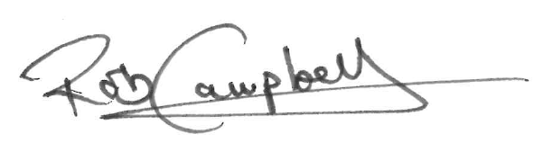

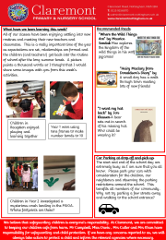
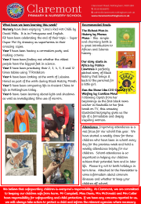
CLAREMONT PRIMARY SCHOOL NEWSLETTER
FRIDAY 6th SEPTEMBER 2024
Dear Parents and Carers, Welcome back to a New Year at Claremont. I hope that you all had a good break and are looking forward to the new school year as much as I am. Following a year of disappointing academic outcomes and low school attendance, we start the year with a new teaching team, a revised curriculum and high hopes and expectations for the coming year. It is absolutely essential that your child attends school every day that they possibly can. There is new guidance from the government aimed at improving attendance nationally and it is something that we must make improvements on. School attendance is linked to attainment – if your child is not in school for whatever reason, they are missing out on their learning so we must all make every effort to ensure that your child does not miss any time at school. We are reviewing our school’s behaviour and relationships policy this term so that we can continue to build Claremont to be that wonderful, safe and caring environment where everyone can thrive and we need your help and support to do this. I am looking forward to a super year, filled with fun and learning. Best wishes, Headteacher
Dates for your diary: 9thSeptember:After school clubs begin. Nottingham Forest working in school Music Camp 13th September: Year 3 swimming/ Year 4 Music Hub 16th September: Year 6 transition meeting in 6OG 22nd October: Half Term Holiday starts
After school clubs and wraparound provision
This term we have a number of after school clubs starting. This is the first year since COVID that we have offered a full range of clubs and so far the demand has been high. These clubs are being run by teachers and support staff and are aimed at providing different sporting, creative and collaborative experiences for our children. Demand has been high this time around but there will an opportunity again after half term.
We also offer a breakfast club from 7.30 – 8.45 every morning. This is a great way for the children to start their day with food, fun and social interaction. Please contact the school office for more details if you are interested in using this facility.
We are also pleased to continue our collaboration with The Lime Trees for after school provision. This is booked directly with them and runs from 3.30pm until 6pm.
We will also be running the holiday club during the second week of half term in October. Watch out for more details.
Attendance: Our attendance target is 97% Last year’s attendance was: 92.5%
Thought of the week: ““Success is the sum of small efforts, repeated day in and day out.” — Robert Collier
We believe that safeguarding children is everyone’s responsibility. At Claremont, we are committed to keeping our children safe from harm. Mr Campbell, Miss Davis , Mrs Cutler and Mrs Khan have responsibility for safeguarding and child protection. If we have any concerns reported to us, we will always take action to protect a child and inform the relevant agencies where necessary.

Slide 2


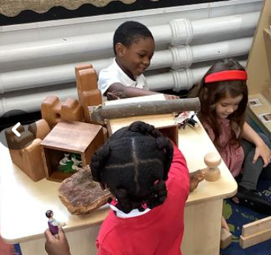
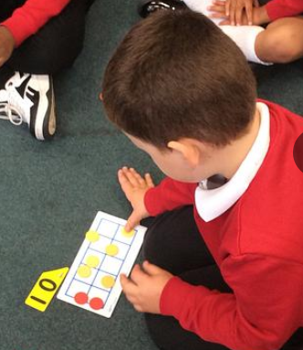

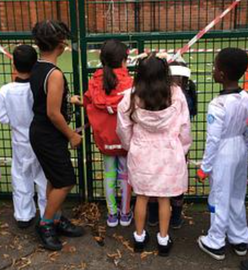
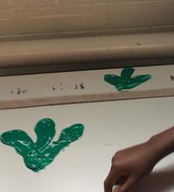

What have we been learning this week? All of our classes have been enjoying settling into new routines and meeting their new teachers and classmates. This is a really important time of the year as expectations are set, relationships are formed and the children (and teachers!) get back into the routine of school after the long summer break. A picture paints a thousand words so I thought that I would share some images with you from this week’s activities.
Recommended Reads
“Where the Wild Things Are” by Maurice Sendak Max explores the kingdom of the wild things in his wolf pyjamas!
“Hairy Maclary from Donaldson’s Diary” by
A small dog has a walk through town meeting lots of new friends!
“I want my hat back” by Jon Klassen A bear sets out in search of his missing hat. Who could be wearing it?
Children in Reception enjoyed playing and learning together
Year 1 were using tens frames to make number bonds to 10
Car Parking at drop off and pick up The start and end of the school day are extremely busy as I am sure that you all know. Please park your cars with consideration for the children, our neighbours and observing the parking restrictions around the school. This benefits all members of our community. Why not try parking a few streets away and walking to the school entrance?
Children in Year 2 investigated a mysterious crash landing in the MUGA. Whose footprints are these?
We believe that safeguarding children is everyone’s responsibility. At Claremont, we are committed to keeping our children safe from harm. Mr Campbell, Miss Davis , Mrs Cutler and Mrs Khan have responsibility for safeguarding and child protection. If we have any concerns reported to us, we will always take action to protect a child and inform the relevant agencies where necessary.

Slide 3


