Slide 1


CLAREMONT PRIMARY SCHOOL NEWSLETTER
FRIDAY 13th FEBRUARY 2026
Dear Parents and Carers, We come to the end of another half term. The days are getting longer and, although the weather has not improved noticeably we are creeping towards Spring time. This term is the real engine house of the learning year. It is important that the children really accelerate their learning and work hard. To that end it is vitally important that they are brought to every session that they possibly can be. I am aware that there is a lot if illness around at the moment, but we can administer medication in school with your permission and would encourage children with colds and sniffles to come to school. As we approach spring, it is important to note that next week brings Chinese New Year. If you are celebrating I wish you all “Kung Hei Fat Choi” as we welcome the Year of the Horse. We also welcome the start of the month of Ramadan next week. Please accept our “Ramadan Mubarak” wishes and I hope that you have a peaceful Ramadan. It is half term next week and I hope that you have a relaxing and peaceful time with your families and I look forward to welcoming you all back on Monday 23rd February. Best wishes, Rob Campbell Headteacher
Dates for your diary: 23rd February – Children return to school after the half term 9th – 13th March – Assessment Week 24th and 26th March – Parents’ Evenings 27th March – Final day of the Spring Term
Behaviour and Relationships Policy
Our behaviour protocols have been in place for half a term now and things are going really well. The children are really engaged with the rewards system and we have our big celebration assembly today. I am very grateful for all of the support that we have received from the parents and children. Everyone has really got on board to make the start a success. There are still a few gremlins in the system and we are ironing those out as we go along but the aim to ensure that every minute in school is a minute spent learning. That can be academically, socially or emotionally. There are number of things that we want in place to ensure that our children are future ready and the themes of Safety, Caring, Achievement, resilience and Friendship are key ingredients to what we are trying to build. Your partnership in this is crucial to the success and we are always keen to listen to your views and value that input. The partnership in helping our children get ready for the next stage of their education is vital to making sure that we develop children who are resilient, caring and well-educated. A huge thank you to Mrs Hurford-Allsopp and all of the staff who have worked extremely hard to develop and embed this approach. Let’s build on this next term and create an even more wonderful learning community.
Attendance: Our attendance target is 96 % This year’s attendance so far is 93.0%
Safeguarding children is everyone’s responsibility. At Claremont, we are committed to keeping our children safe from harm. Mr Campbell, Miss Davis , Mrs Cundy, Mrs Khan, Mr Greaves & Mrs Eager have responsibility for safeguarding and child protection. If we have any concerns reported to us, we will always take action to protect a child and inform the relevant agencies where necessary..

Slide 2

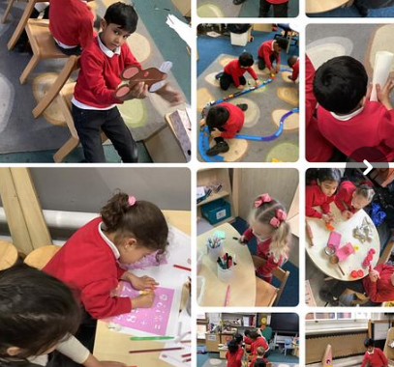
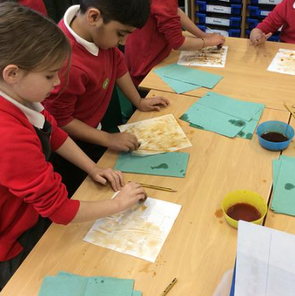
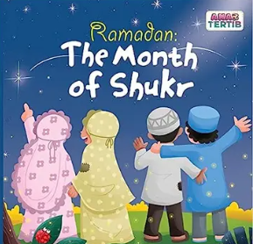

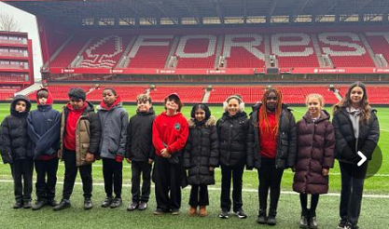
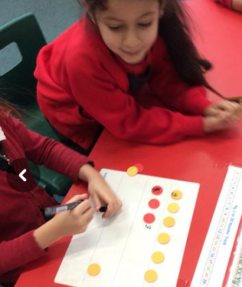
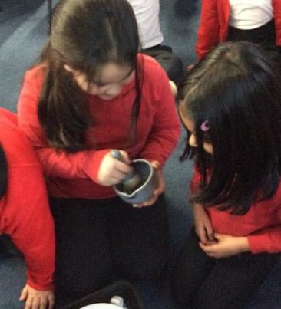
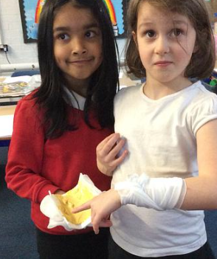
What have we been learning this week? Nursery and Reception have been learning about the Great race of the animals and traditions around Chinese New Year. Year 1 have been staining paper to write realistic accounts of the Great Fire of London Year 2 have been comparing modern medicines with remedies from the past. Year 3 had their meeting about the upcoming residential! Year 4 have been learning about keeping safe in RHSE Year 5 have visited the Galleries of Justice to learn about crime and Punishment in Nottingham throughout history. Year 6 Some of the children visited Nottingham Forest this week as part of the rainbow Laces initiative. Acorns have been reading the story of jack and the Beanstalk.
Recommended Reads
The Great Race by Emily Hiles . The Jade Emperor decides there should be a race to decide the best animal. Who will win?
Ramadan: The Month of Shukr by Sidra Hashmani A story that teaches children about gratitude, empathy, generosity and more.
Ramadan Kareem– a big-hearted celebration of the joys and traditions of Ramadan around the world
Parental Engagement Thank you to everyone who voted in our Parent Governor elections. I am delighted to announce that Hugh Dichmont was elected to represent the parents at our Governing Body meeting. Also a HUGE thank you to everyone who supported our PTFA discos. A particular shout out to Mrs Bilson and her team of volunteers who put on two fantastic discos for our children this week. A large number of children attended both events and great fun was had by all. A big thank you also to all of the school staff who stayed to support including the amazing DJ Peel who provided the children with music, lights and entertainment!! If you would like to join our PTFA, please contact Mrs Bilson at the PTFA.
Safeguarding children is everyone’s responsibility. At Claremont, we are committed to keeping our children safe from harm. Mr Campbell, Miss Davis , Mrs Cundy, Mrs Khan, Mr Greaves & Mrs Eager have responsibility for safeguarding and child protection. If we have any concerns reported to us, we will always take action to protect a child and inform the relevant agencies where necessary.

Slide 3


